Slide 1
Finding Michael & Elizabeth (Lewis) Henn 1860, 1850
Getting Lost in the Big City

Slide 2
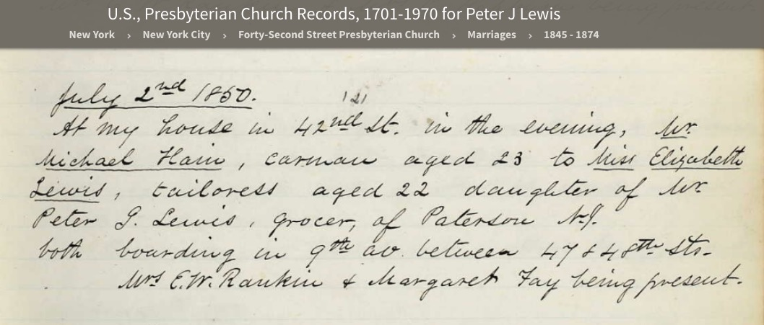
Michael Henn- Elizabeth Lewis Marriage

Slide 3
What do we know from this record?
Married July 2, 1850; 42nd St. Presbyterian Church in New York City
He a carman, age 23
She a tailoress, age 22
  Dau of Peter Lewis, a Grocer in Paterson NJ
Both board 9th Ave between 47th & 48th St.
Witnesses Mrs. E.W. Rankin and Margaret Fay

Slide 4
And from subsequent research
Michael and Elizabeth (Lewis) Henn had a son Daniel b. abt. 1851 in NY, probably NYC
Michael b. abt 1827 Prussia/Germany
Elizabeth b. abt 1828 New Jersey (ps. NY)
No other known children born between 1851 and 1860 survived (at least one little boy died)
Several ch b. 1860-1870, all in NY
They are in NYC 1870, 1880; Michael d. 1884
Elizabeth is in NYC in 1900, a widow
Census day in 1850 and 1860 is June 1.

Slide 5
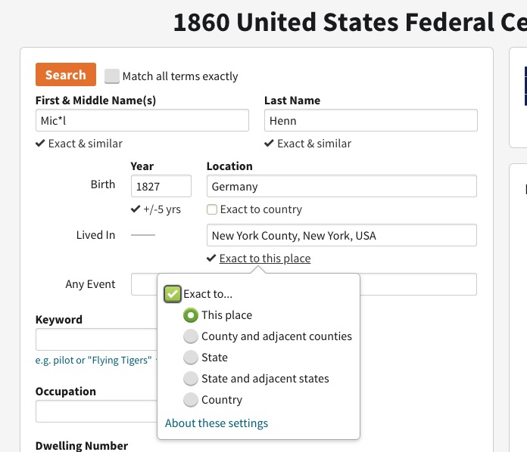
Hypothesis: they are in New York City in 1850 and 1860 – or possibly NJ

Slide 6
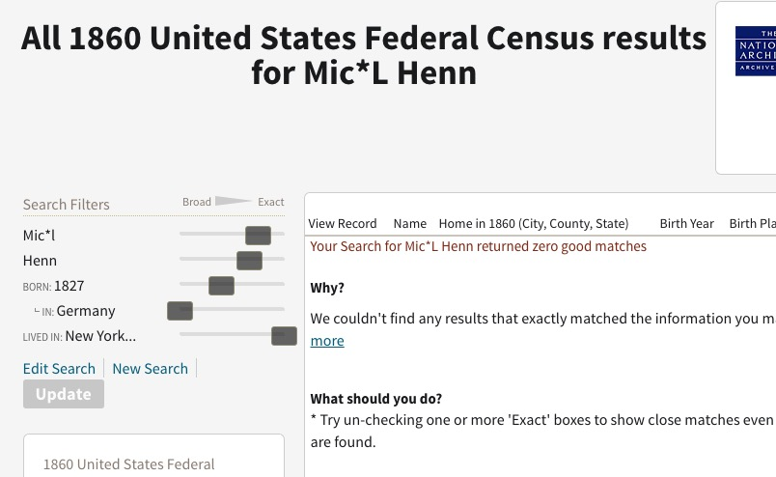
Nope…

Slide 7
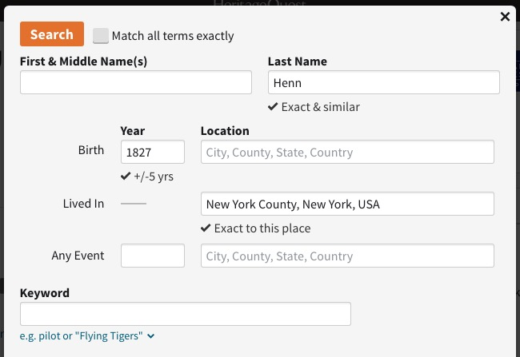
Edit the search to make it broader… no first name and no birth country

Slide 8
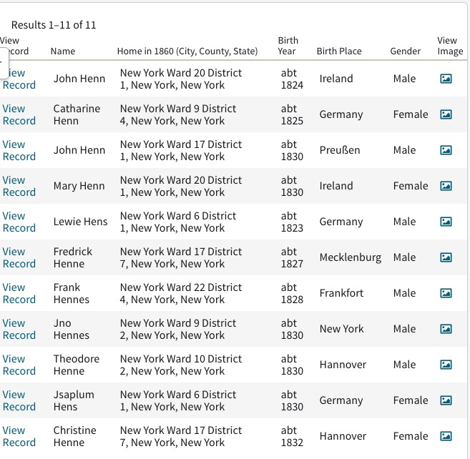
Found some Henn entries – no Michael, no Elizabeth

Slide 9
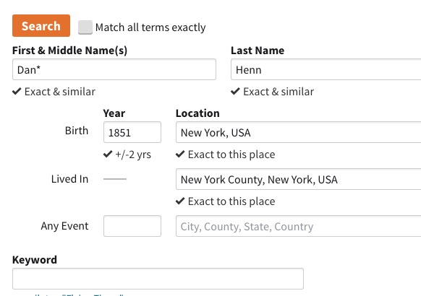
Let’s look for Daniel

Slide 10
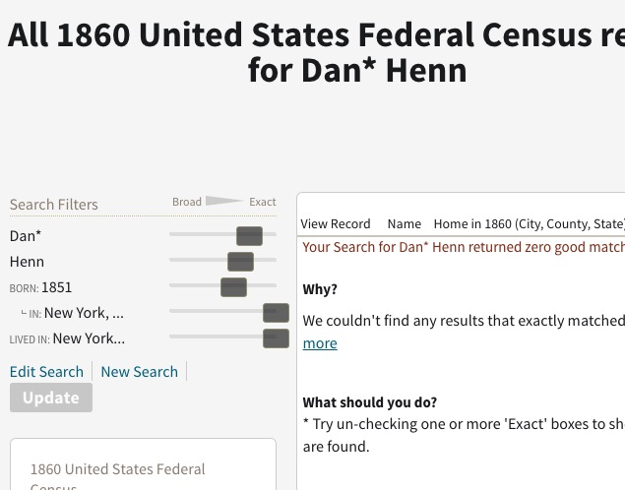
Nope…

Slide 11
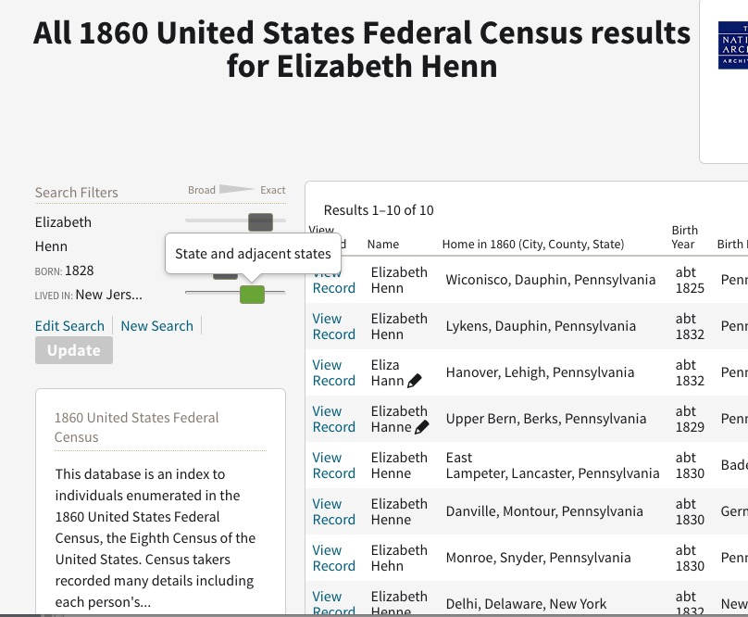
Didn’t find Elizabeth in NJ or in any state adjacent to NJ

Slide 12
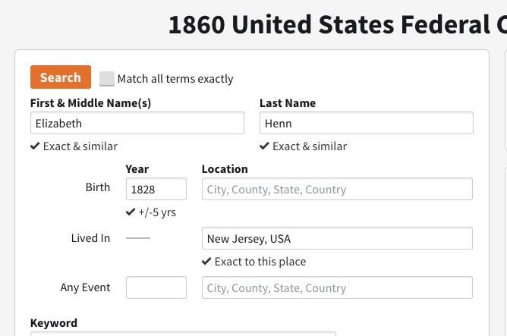
Maybe they are in NJ after all…

Slide 13
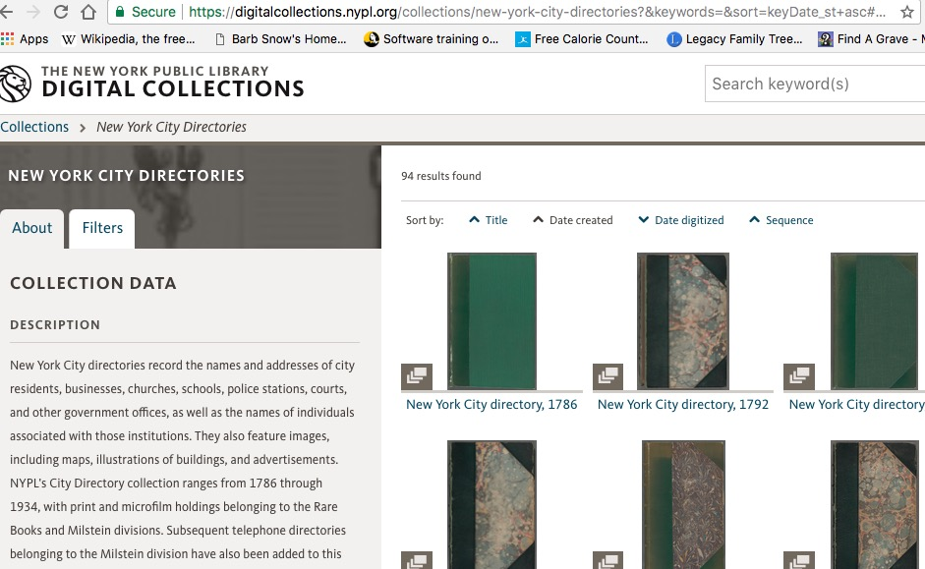
One way to test that hypothesis is with a city directories

Slide 14
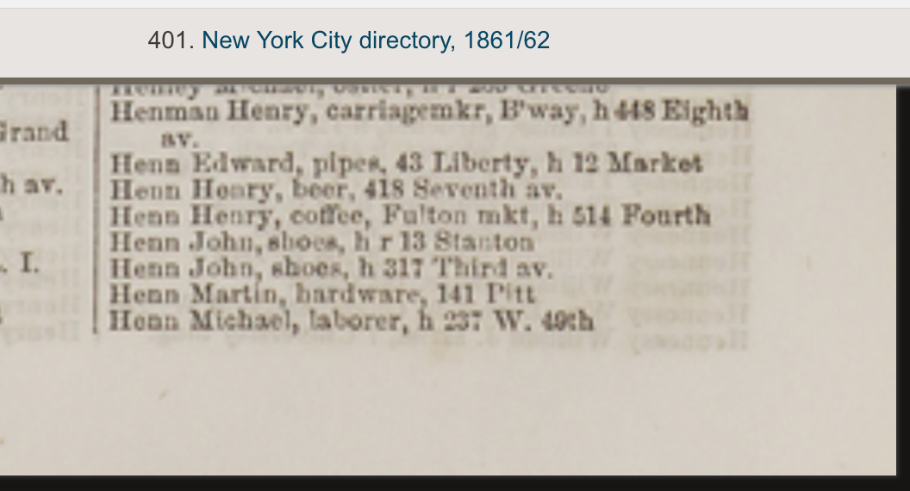
In 1861/62 they ARE in NYC

Slide 15
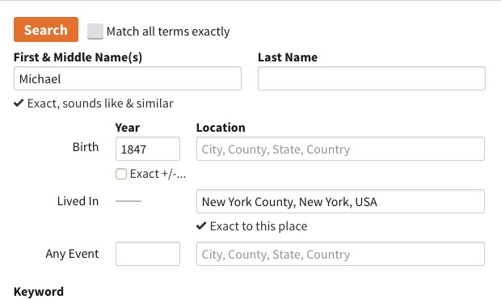
Let’s search without the last name
A search with Germany as
birthplace failed

Slide 16
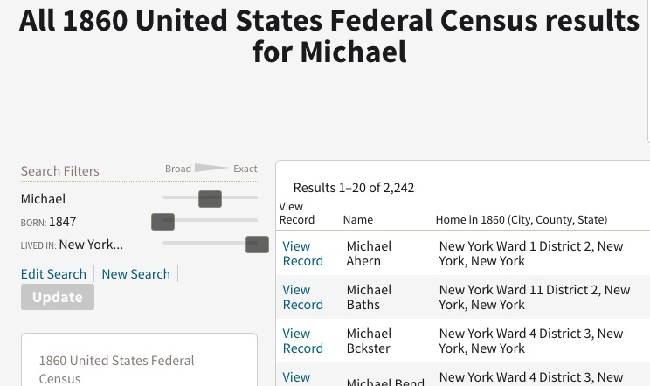
So I had to check 2,242 entries—but navigate first to H surnames

Slide 17
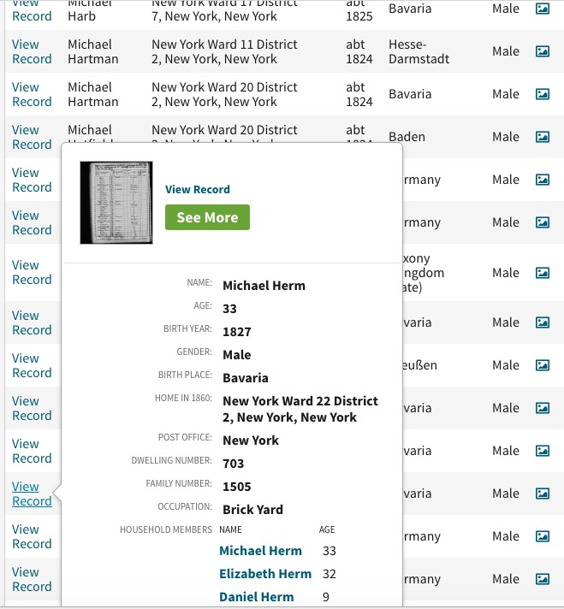
Pop Ups let you quickly see if a record is the one you want.

Slide 18
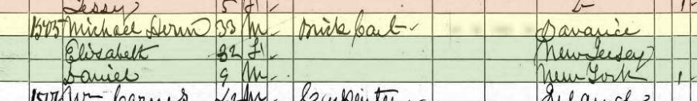
And here they are…a perfect match
Michael Herm 33 occ: Brick Cart b. Bavaria
Elizabeth 32 b. New Jersey
Daniel 9 b. New York

Slide 19
Can we find them in 1850?
They married July 1
Census day was June 1; so they should be enumerated as a married couple, again probably in NY
No search was successful.

Slide 20
Let’s look at city directories

Slide 21
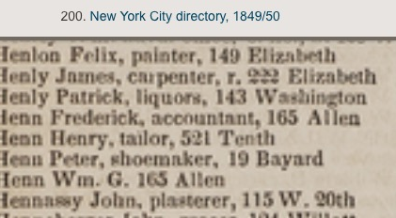
Not there 1849/50

Slide 22
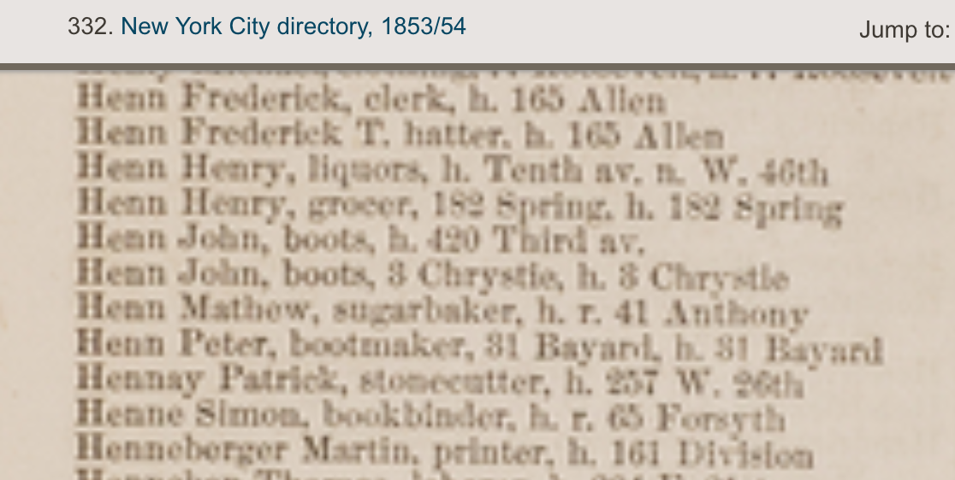
Not there 1853/54

Slide 23
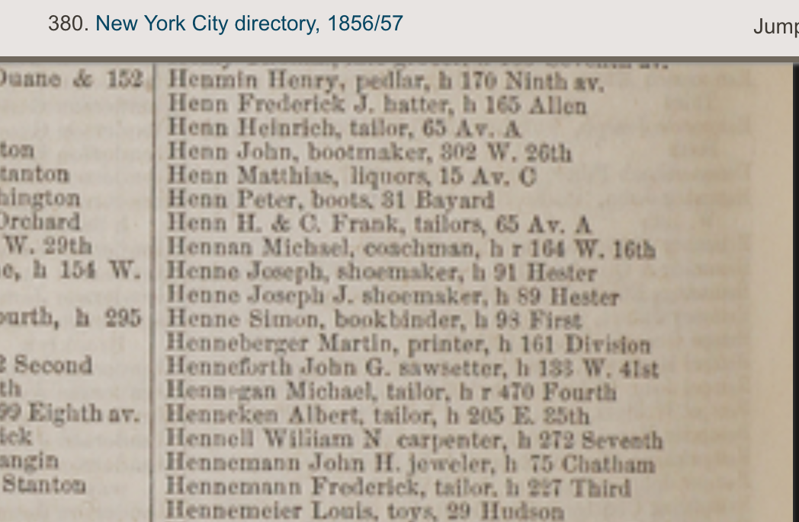
Not there 1856-57

Slide 24
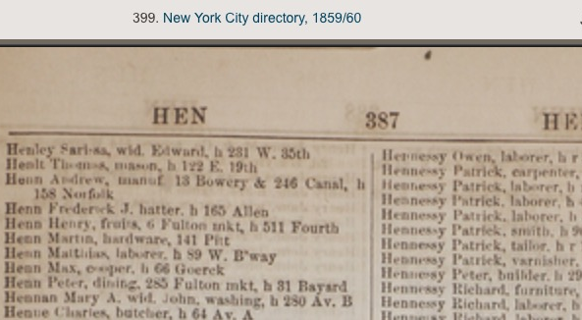
Not there 1859/60

